Slide 1
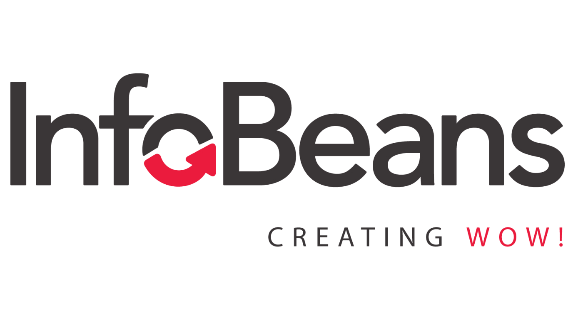
POC
on
Katalon Studio
-Sagar Salunke

Slide 2
Agenda
Katalon Studio Introduction
Katalon Studio Products
Katalon Studio Features
Comparison with Selenium
Pros and Cons
Demonstration

Slide 3
Katalon Studio
Katalon Studio is one of the recognized tools for automated testing.
Katalon studio tool is Robust, Intelligent and scalable automation tool.
Full package of powerfull features.

Slide 4
Katalon Studio Products
Katalon Studio
Katalon RunTime Engine
Katalon TestOps
Katalon Recorder
Katalium
Katalon store

Slide 5
Katalon Studio Features
Testing Environments
  Windowa, MacOS, Linux
  Applications under Test
    Web testing
    Mobile testing
    API testing
    Desktop application testing
    Data-driven testing
    BDD testing

Slide 6
Katalon Studio Features
Supported Browsers
  Google Chrome, Firefox, Microsoft Edge, Safari, Headless.
  Scripting Language
    Groovy
    Object Storage and Maintenance
      Page Object Model
      Continuous Integration
        Jenkins, JIRA.

Slide 7
Katalon Studio VS. Selenium
Feature | Selenium | Katalon Studio
Initial Release | 2004 | 2015
Products | Selenium init, Selenium RC, Selenium Web Driver, Selenium Grid | Katalon Studio, Katalon RunTime Engine, Katalium
Supported Language | Java, Ruby, C#, PhP, Python, Perl | Groovy(Java)
Price | Free | Free Trail(30 days) and Paid Versions
Browser Support | All | All
Integration Options | CI/CD integration with Jenkins and other tools | CI/CD integration with Jenkins and other tools

Slide 8
Katalon Studio PROS
Supports several types of testing:
  Keywords-driven.
  Data-driven
  API-testing
  Cross-browser
  User-friendly GUI
  Inbuilt analytics dashboard and reports
  Mild learning curve + learning materials

Slide 9
Katalon Studio CONS
Not open source
Lack of scripting languages
Small community

Slide 10
Katalon Studio Demonstration
Installation
Test Case Creation
Test Case Execution
Logs and Reports
Global Variables
Data Driven Testing
Listeners
Handling Alerts and pop-ups
REST API Testing
BDD Framework

